Slide 1
Rampart™ Armor for Modern
Software IMPACT Conference 2022
Jacob Staples
jstaples@securboration.com
1

Slide 2
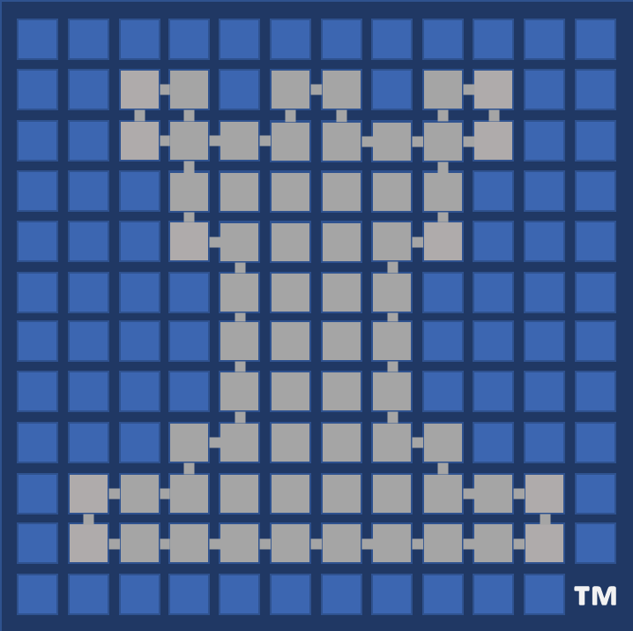
# Strategic \
> Cybersecurity \
> Research \
> Group

Slide 3
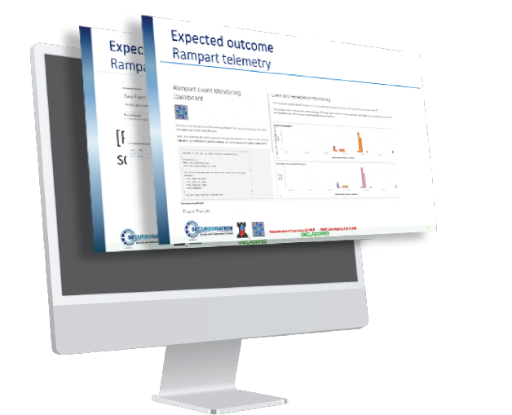
Innovation
-Rampart™ protects software from attacks that other tools miss, including zero-day exploits
-Rampart™ uses continuous behavior-based analysis to identify and block application misbehavior (instead of signatures or heuristics)
-Rampart™ is powered by ML; training is automated and can be easily integrated into existing CI/CD pipelines
Rampart™ Agent
Rampart™ uses ML to block the exploits that lead to data breaches
App behavior
Alerts &
actions
Expected behavior

Slide 4
Mission
-Building secure software is hard. Keeping deployed software secure is even harder.
-Rampart™ builds and enforces behavior models to ensure your apps operate within a safe execution envelope.
-Rampart™ provides a true zero-day attack prevention capability that blocks unwanted behaviors in an unpatched system at their first point of occurrence.
-Rampart™ shortens the response time to emergent threats—giving both production and development teams the forensics they need to determine impact and response.
Rampart™ continuously monitors mission-critical software to ensure operation within a learned safe behavior envelope.

Slide 5
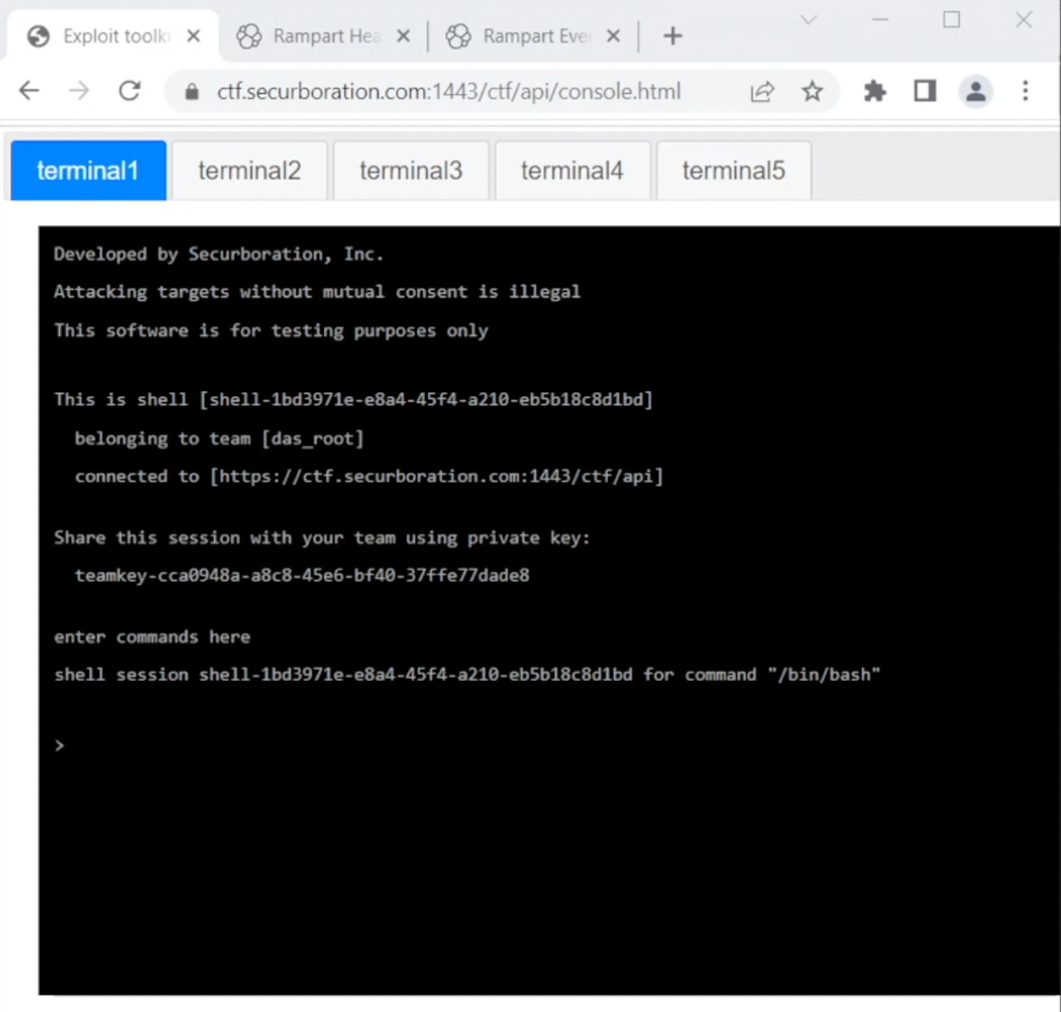
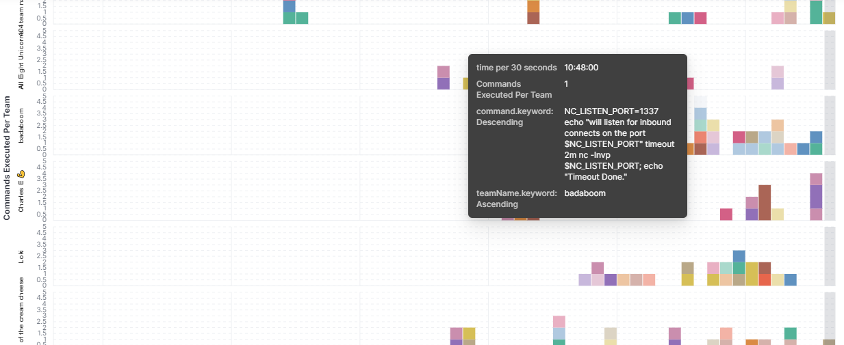
Performance
Rampart Cyber Test Range
-Rampart™ supports continuous monitoring of any containerized application. Dynamic attack blocking capability implemented in Java, Python, and .NET.
-Continuous testing, hands-on penetration test exercises and live demos within the Rampart™ Cyber Test Range provide evidence of capability relevant to recent high-impact CVEs.
-Fast Chats from industry leaders solidify the standing of Rampart™ as a superior security solution.
Demo: https://www.youtube.com/watch?v=A7PuYT6_-44
Here we see Rampart™ blocking a team of professional pentesters with no perceptible QoS penalty.

Slide 6
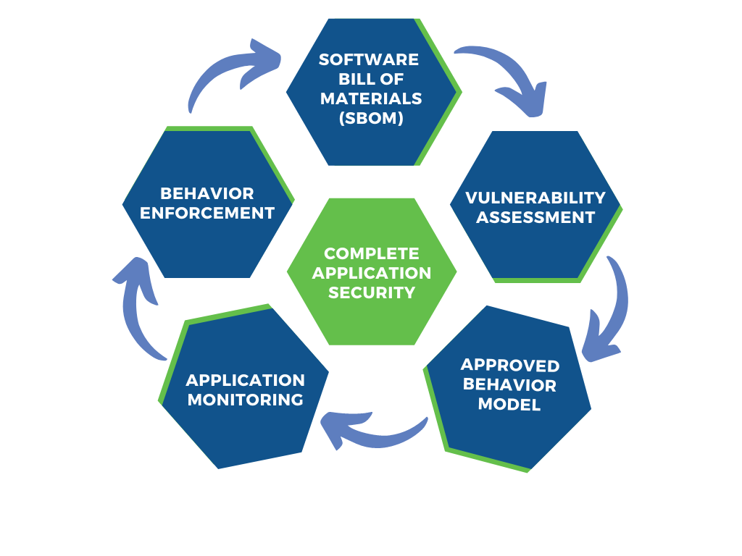
Accelerate
-Rampart™ enables DEVOPS teams to more securely deploy applications faster.
-Rampart™ allows production engineers to move away from a reactive patch-oriented mindset and instead focus on maximizing uptime and quality of service.
-Rampart™ uses an integration-as-configuration approach that easily hooks into your existing CI/CD process. No software re-writes are required.
With Rampart™, your engineers focus on maximizing user experience instead of chasing down patches.

Slide 7
Cost
$9.44M
The costs of cybercrime are staggering. Virtually every major industry affected but healthcare and manufacturing most at risk.
$10.5T
2 config lines
Rampart™ is quick and easy to configure and deploy. Monitor any application. Block high-severity attacks at their point of entry.
Groovy
Go
R
C
Java
VB
Python
C++
C#
JS
Rust
Data breaches are too costly for purely reactive approaches to be acceptable. Rampart™ blocks breaches at their point of entry.
Rampart’s use in production systems is all but invisible to end users while keeping attackers at bay.
~5%
Zero.
<1ms
Notes:
9.44m Average cost of a data breach in the US
https://www.ibm.com/reports/data-breach
$1.12M Average savings if a data breach is contained in 200 days or less
https://www.ibm.com/reports/data-breach
$10.5T Cost of cybercrime in 2025

Slide 8
Transition
# Strategic \
> Cybersecurity \
> Research \
> Group
-Securboration will commercialize Rampart™ via its Rampart AI spinoff
-Rampart AI will provide support for various government clients that use Rampart™
-The Rampart™ team is working with additional government program offices to validate the technology
Follow Rampart™ at
https://www.rampart-ai.com/blog

Slide 9
I.M.P.A.C.T Summary
Innovation – Rampart™ learns how an application normally behaves and blocks/alerts other behaviors that occur in production. It is entirely agnostic of attack vectors/signatures.
Mission – Enable production teams to achieve more resilient software deployments.
Performance –Exercises within our cyber range prove the ability of Rampart™ to block attacks. Rampart™ supports a variety of languages and is cloud-friendly.
Accelerate – Rampart™ responds at machine speed to misbehaviors of production software.
Cost – Rampart prevents the application-level misbehaviors that lead to data breaches. Data breaches at US companies cost an average of $9m in 2022.
Transition – Rampart™ is undergoing final proveout within Customer test environments and will be commercialized under the Rampart-AI™ spinoff.

